Slide 1


Session Id: 1.2
Session title: Recent advances in system modelling and simulation
Session Chair: Dr. Michael Winokur
Lecture title
Dr. Michael Winokur and Avi Zaguri,
Faculty of Technology Management - HIT
In collaboration with

Slide 2
Contents
Background Brief History "Modeling Tools for CPS Systems" Industry Usage New Trends Research at HIT
Objectives
Case studies Main Findings Simulation demo Insights and Conclusion
Future Research Plans

Slide 3
Brief History "Modeling Tools for CPS Systems"

Slide 4


Complex software-intensive systems (CPS)
(*) Cyber-Physical Systems (CPS) comprise interacting digital, analog, physical, and human components engineered for function through integrated physics and logic .
(**) Ongoing advances in science and engineering improve the link between computational and physical elements by means of intelligent mechanisms, increasing the adaptability, autonomy, efficiency, functionality, reliability, safety, and usability of cyber-physical systems. (e.g., collision avoidance, robotic surgery , deep-sea exploration , augmentation of human capabilities )
(*) https://www.nist.gov/el/cyber-physical-systems
^{(**)} https://en.wikipedia.org/wiki/Cyber-physical_system

Slide 5
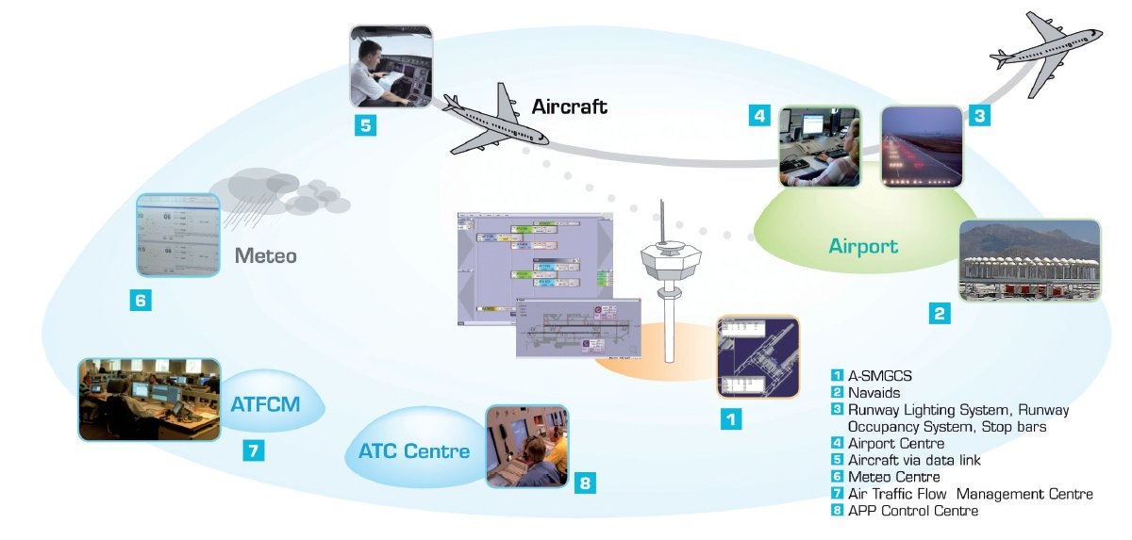
CPS EXAMPLE: Air Traffic Control

Slide 6
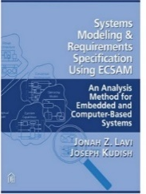
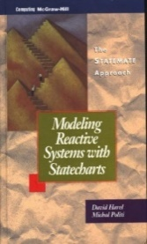
The 80’s
A very complex project (such as Lavie in Israel) promotes the development of modeling tools and methods
Very intensive activity on the subject:
STATECHARTS
STATEMATE tool
ECSAM modeling method
A comprehensive article describing the development: StateChart in the Making: A Personal Account- Prof. David Harel
Systems Modeling & Requirements Specification Using ECSAM: An Analysis Method for Embedded and Computer-Based Systems
by Jonah Z. Lavi and Joseph Kudish
Modeling Reactive Systems with StateChart :The Statement Approach
by David Harel and Michal Politi

Slide 7
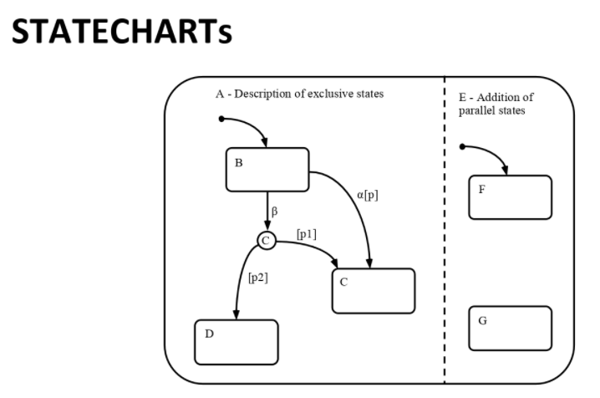
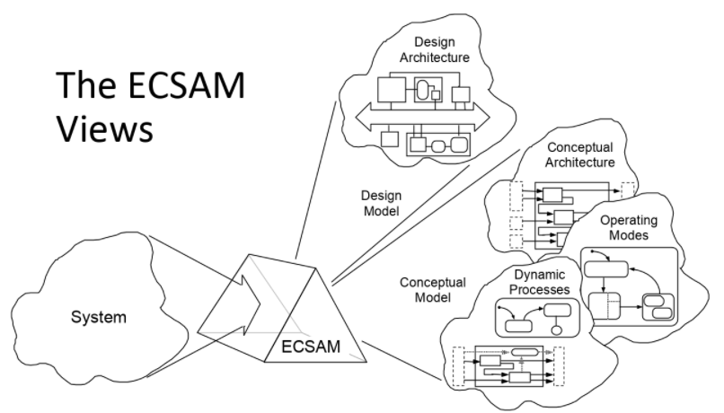
ECSAM method
A method for presenting engineering requirements and models for computer-based systems
Displays the system using three complementary consistent views
The modeling is done in a way that is appropriate for systems and subsystem analysis
Based on the StateCharts language published by Prof. David Harel David Harel. (2007). Statecharts in the Making: A Personal Account. The Weizmann Institute of Science.

Slide 8
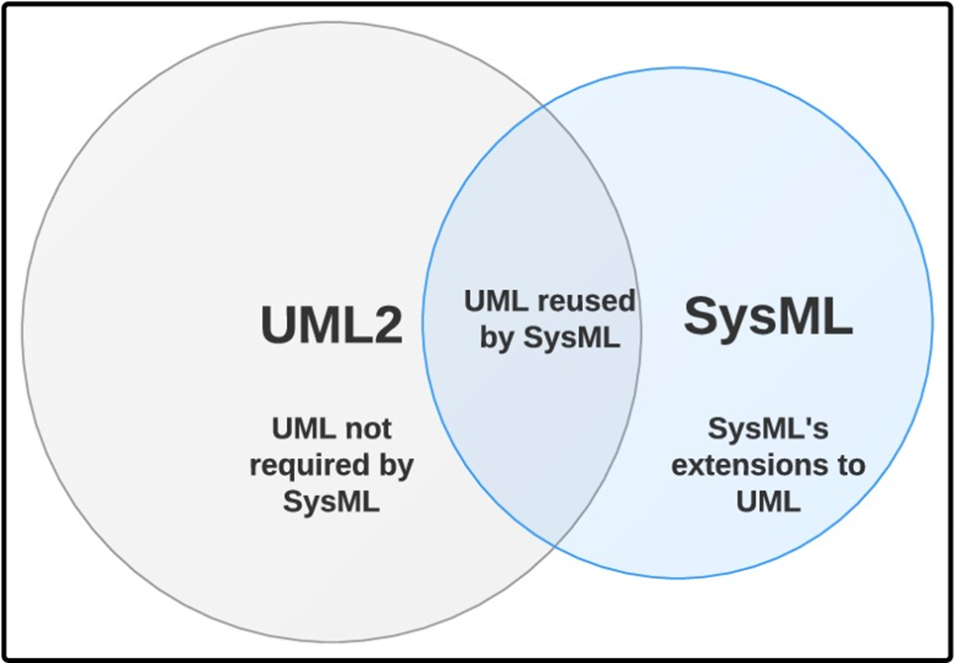
90’s and 2000’s (continued)
Unified Modeling Language -UML in the software
SysML: A derivative of UML for systems
Additional initiatives:
OPM (language and tools) led by Prof. Dov Dori at the Technion https://en.wikipedia.org/wiki/Object_Process_Methodology
Language and tools MODELICA https://www.modelica.org
.......
OMG Systems Modeling Language (OMG SySML™), Version 1.3. (2012, June). https://www.omg.org/spec/SysML/1.3/PDF

Slide 9
Status of use in modeling tools (1/2)
Modeling in engineering disciplines with the help of computerized tools are standard in Industrial use and Academic Courses teaching.
Examples:
Modeling and automatic production of software using UML
CAD-CAM in Mechanical Engineering: Design, Analysis and Simulation (Example: https://www.youtube.com/watch?v=VJpB4szpfTY
CAD-CAM in Electronics: A modeling tool from the design stage to implementation

Slide 10
Status of use in modeling tools (2/2)
Modeling CPS systems with computerized tools (Model Based Systems Engineering):
For about 30 years there has been the development of tools, modeling languages and international standardization efforts
Courses on the subject are taught in academia and professional associations of systems engineering
The use in industry, except in isolated cases, "does not take off“
Common situation: Using software tools for drawing, without formal language, without analysis and without simulation
The exception: automated tools for managing textual requirements and generating specifications (without modeling)
WHY ??

Slide 11
90’s and 2000’s (continued)
Large EC-funded consortium to implement the tools:
Speeds
Danse
What in reality ??
The use of industry, except in isolated cases, "does not take off“
Common situation: Using software tools for drawing, without formal language, without analysis and without simulation

Slide 12
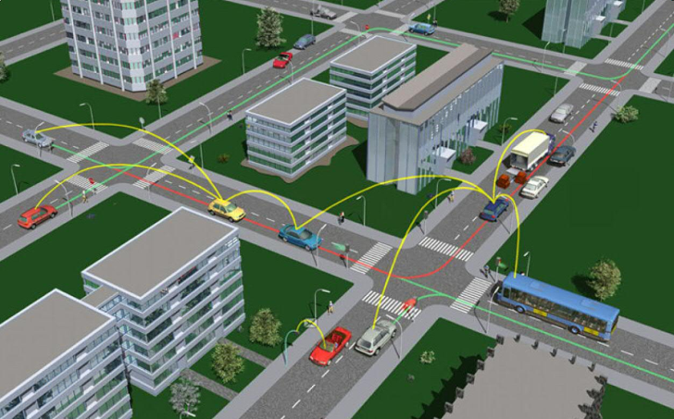
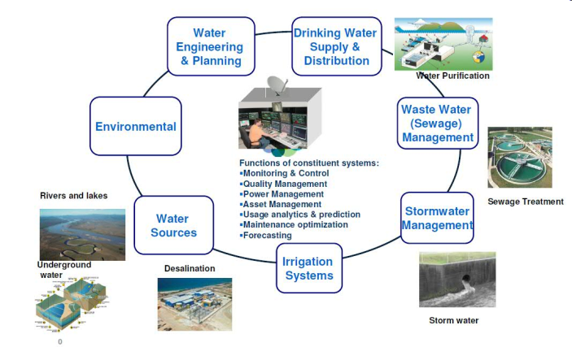
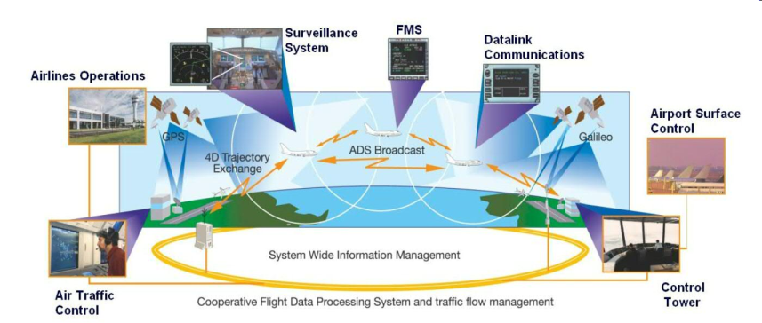
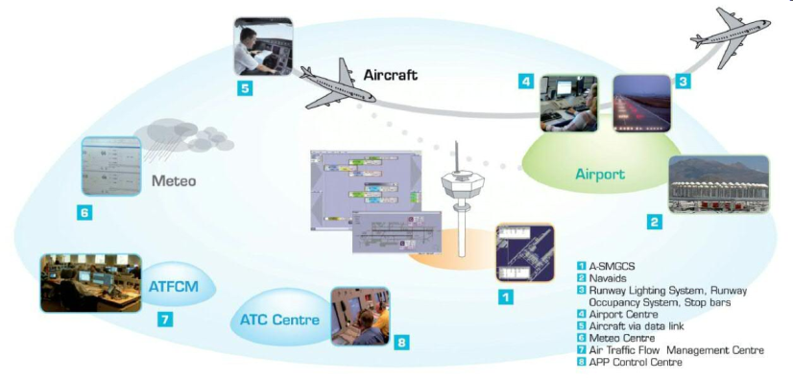
Validation of new SoS approach
Real industrial problems planned for Commercial development :
Air Traffic Management,
Autonomous Ground Transport,
Integrated Water Treatment and Supply
12

Slide 13

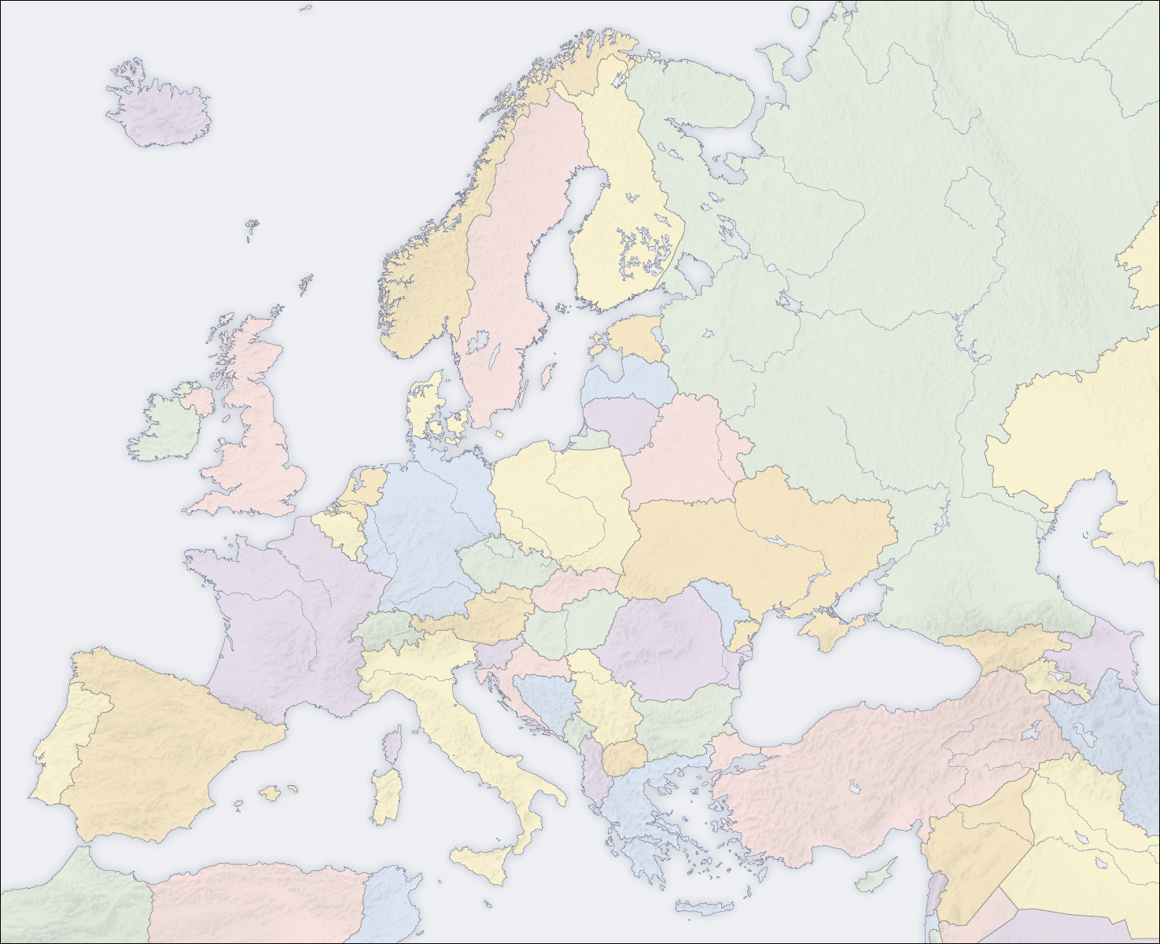









DANSE Consortium
Industry
Tool Vendor
Associated Partner:
Research

Slide 14
The main causes of the problem
Man-machine interface is relatively inconvenient for computerized drawing tools
A complex learning curve of the modeling tools and languages
The complexity of saving the model when there are changes during the project
The investment required to build and maintain the model outweighs the expected benefit of consistent analysis and behavioral simulation

Slide 15
New Trends
MATHWORKS company recognizes the problems and opportunity for system development including SYSTEM COMPOSER
The first version will be distributed for use in 2019
Many members of the OMG consortium identify the problem and initiate a new initiative for SysML v2
And we jump into the “research subject” pool again, with the help of the new generation of tools

Slide 16
The Research conducted

Slide 17
The purpose of the Research
Comparative Research between several languages, methods and modeling tools to examine their present usability status

Slide 18
Research questions
What is the "ideal" modeling method for systems engineering and in what layer (system or components) should it be performed?
What is more effective: A modeling tool accompanied by a known language / method that has the ability of link to the physics of the system parts within the same tool or a combination of different system modeling and drawing tools?

Slide 19
Research framework
Preliminary screening of the variety of languages / methods and modeling tools in the research
A decision of using tools and languages recognized in industry in the country
The tools and methods selected are:
Modeling tools: System Composer and Enterprise Architect
Modeling Methods/languages: ECSAM and SysML
Diagram tools: Visio
The relationships between the languages ​​/ methods of the modeling tools and the drawing tools that researched:
System Composer with ECSAM
Enterprise Architect with SysML
Visio with ECSAM

Slide 20
TEST CASES

Slide 21
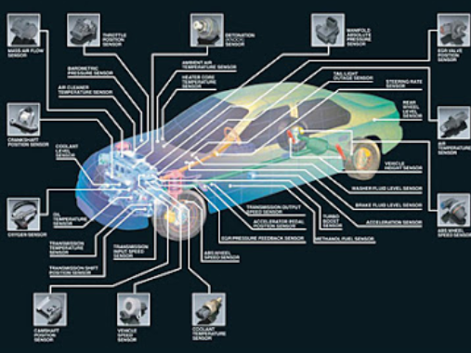

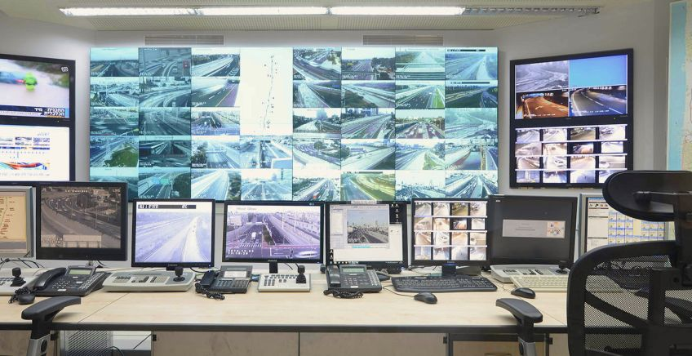
"360-degree Car Damage Monitoring"
"360-degree car damage monitoring" - a high-complexity integrated system with sub-systems with medium / high complexity

Slide 22
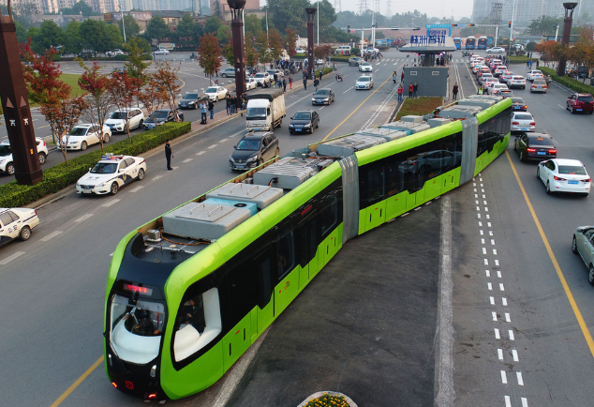
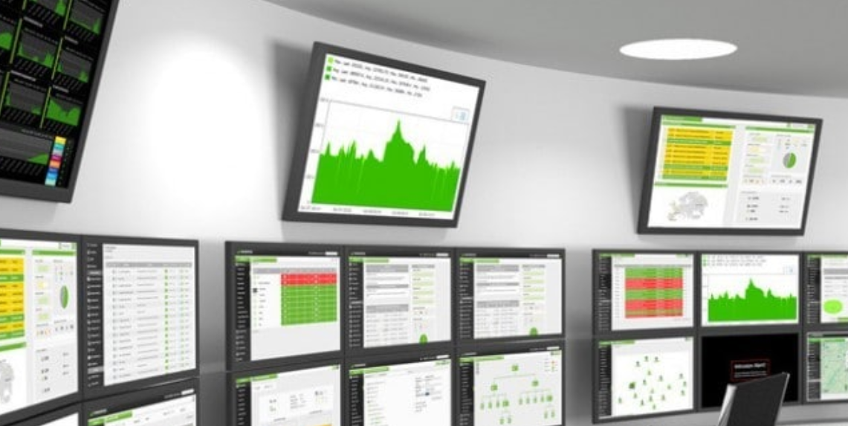
"Smart train carriages management"
"Smart train carriages management" - an integrated system with medium / high complexity with many identical subsystems with low complexity

Slide 23
The indices for examining the research questions
INDICATOR | Research question | No.
1. Visual convenience | What is the "ideal" modeling method for systems engineering and in what layer (system or components) should it be performed? | 1
2. A modeling language is familiar to all project participants
3. Performing re-setting / updating setting
4. IN \ OUT - change inputs and outputs in the various systems
5. Architecture changes by moving elements
6. Effect of changes in the middle of the project
1. Visual convenience | What is more effective: A modeling tool accompanied by a known language / method that has the ability of link to the physics of the system parts within the same tool or a combination of different system modeling and drawing tools? | 2
2. Performing re-setting / updating setting
3. IN \ OUT - change inputs and outputs in the various systems
4. Architecture changes by moving elements
5. Effect of changes in the middle of the project
1. Visual convenience | To which extent is there an advantage to modeling tools over using Visio drawings? | 3
2. Performing re-setting / updating setting
3. IN \ OUT - change inputs and outputs in the various systems
4. Architecture changes by moving elements
5. Effect of changes in the middle of the project

Slide 24
Indicators for examining research questions
Weights | Indicators
20% | Visual convenience
20% | Performing re-setting / updating setting
10% | IN \ OUT - change inputs and outputs in the various systems
10% | Architecture changes by moving elements
10% | A modeling language is familiar to all project participants
30% | Effect of changes in the middle of the project

Slide 25
Results Summary

Slide 26
Advantages and disadvantages - System Composer + ECSAM
Advantages
Clear visual display
Switch in a simple and immediate way between the various components
Add and remove components easily and quickly
A simple link between the various components
Receive data on each link (parameters, protocol, inheritances if any, etc.)
Linking the requirements documents / parts of the document to each component in the system
Perform simulations in a simple way while receiving data on each and every step
Duplicate large and complex elements
Ability to share the project in a simple way
Disadvantages
Changing architecture can be very complicated
Unable to produce a summary/report document for all/part of system components
Inconvenient WEB interface for sharing project architecture to a user without MATLAB

Slide 27
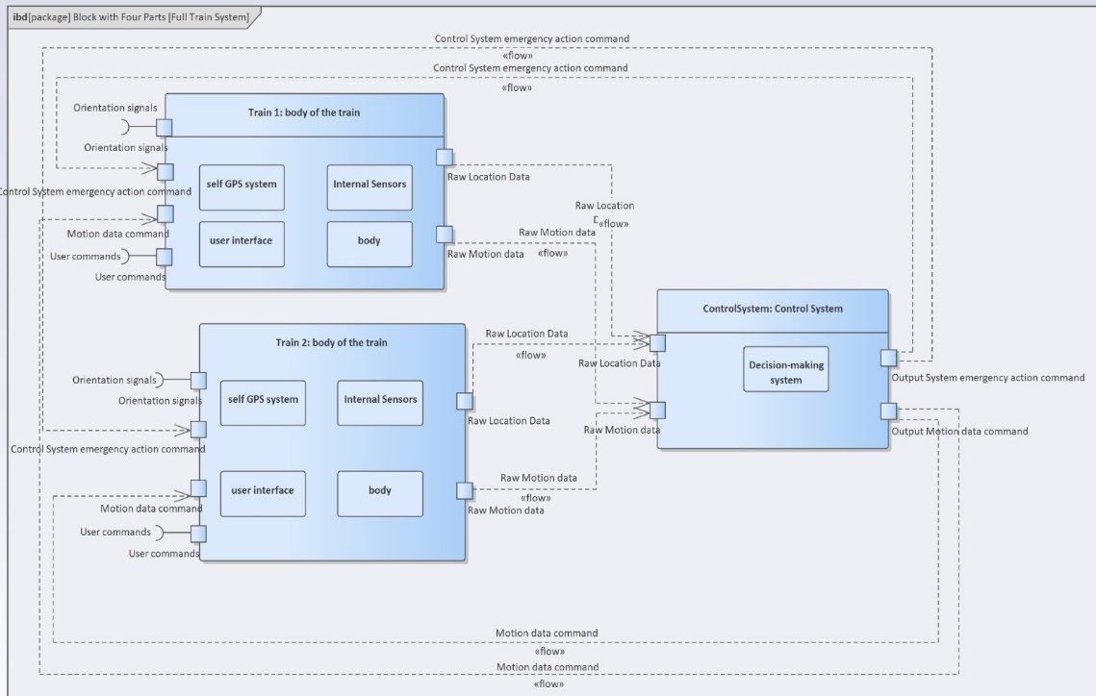
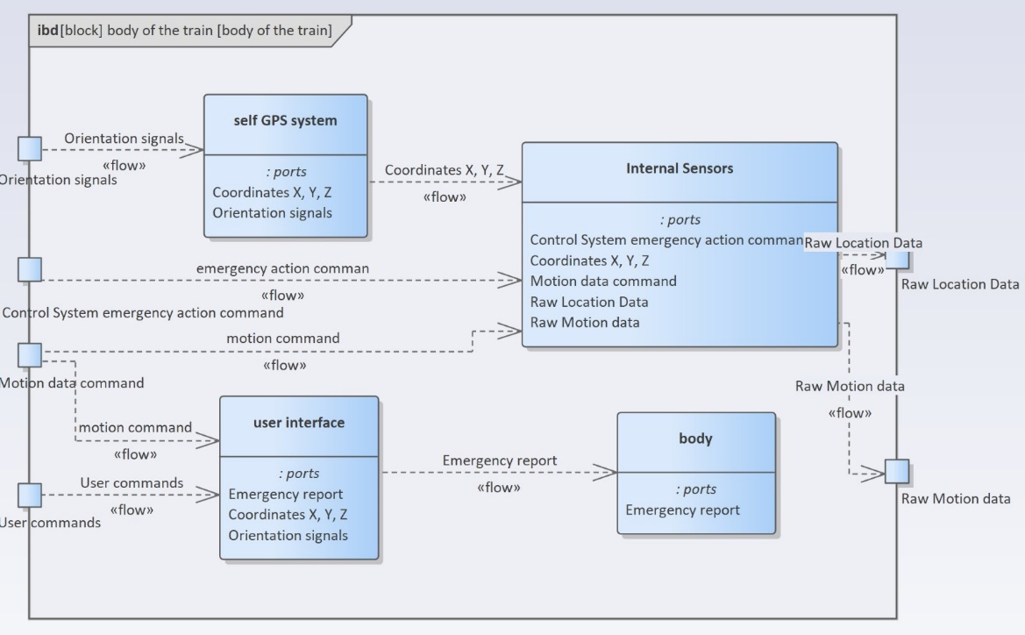
דוגמא – Enterprise Architect + SysML
מתוך כלי Enterprise Architect – "ניהול מערך קרונות חכם"
IBD כללי של כלל המערכת
מתוך כלי Enterprise Architect – "ניטור 360 מעלות"

Slide 28
Advantages and disadvantage - Enterprise Architect + SysML
Advantages
Clear visual display
Move easily between the different levels
Work in an orderly hierarchical manner (according to the SysML language)
Add and remove components easily and quickly
A simple link between the various elements
A recurring element is required in construction only once
Disadvantage
A major change after modeling the overall architecture can be complex
A change in IBD of an individual block does not affect the overall IBD
Inability to perform modeling on a physical level

Slide 29
דוגמא – Enterprise Architect + SysML
מתוך כלי השרטוט Enterprise Architect – "ניהול מערך קרונות חכם"
IBD כללי
מתוך כלי השרטוט Enterprise Architect – "ניהול מערך קרונות חכם"
IBD פרטני

Slide 30
Advantages and disadvantages – VISIO + ECSAM
Advantages
Diagramming software market leader
Has a wide variety of diagram shapes
Most professionals are familiar with the software and how to use it
Add and remove components easily and quickly
Simply link between the various components
Duplicate large and complex elements
Ability to share the project in a simple way without download / buy the software
Inconvenient WEB interface for sharing project architecture to a user without Visio
Disadvantages
Building the model takes a long time to design it to a readable and clear level
Can change several times, due to unreadable construction
Changing architecture can be very complicated
No ability to receive data on each link (parameters, protocol, etc.)
The data on each link must be written in a static-regular manner
There is no ability to link documents to the various diagrams in the system
There is no ability to perform simulations and as a result there are no analysis capabilities

Slide 31
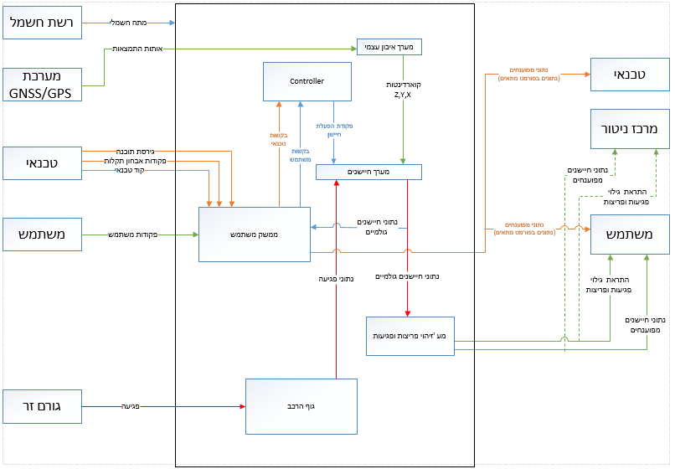
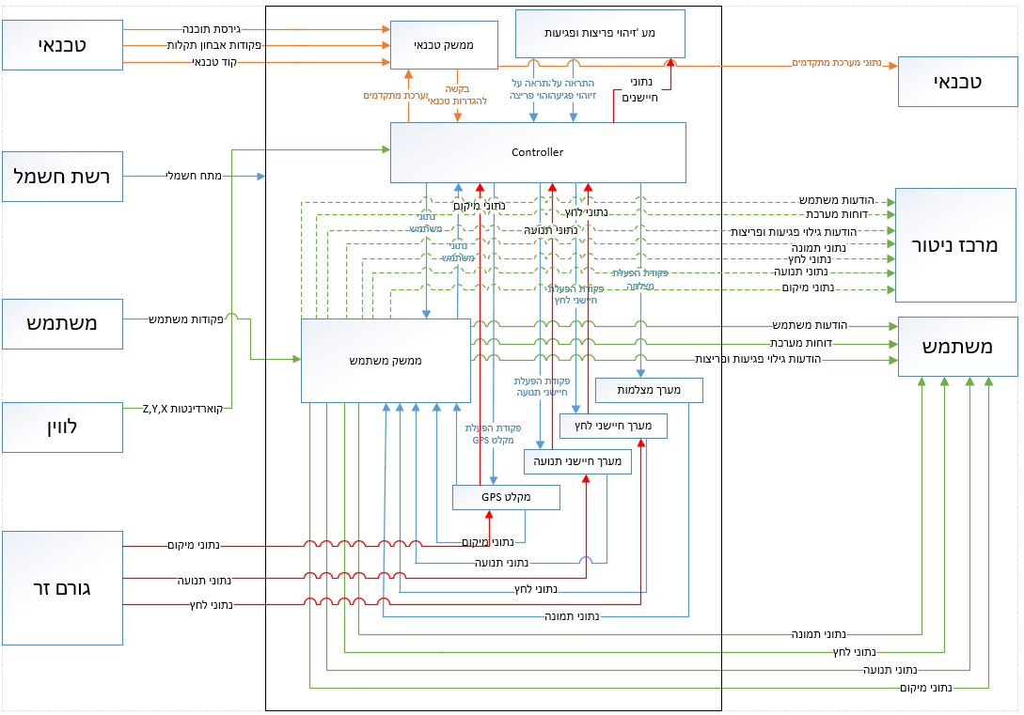
דוגמא - VISIO
מתוך כלי השרטוט Visio – "ניטור פגיעה ברכב 360"
השרטוט אחרי ההתנסות ב- System Composer
מתוך כלי השרטוט Visio – "ניטור פגיעה ברכב 360"
השרטוט לפני ההתנסות ב- System Composer

Slide 32
Summary of research results
כלי ושיטה | תוצאת סיכום מדדים משוקלל
System Composer + ECSAM | 9
Enterprise Architect + SysML | 7.5
Visio + ECSAM | 5.3

Slide 33
Simulation Capabilities

Slide 34
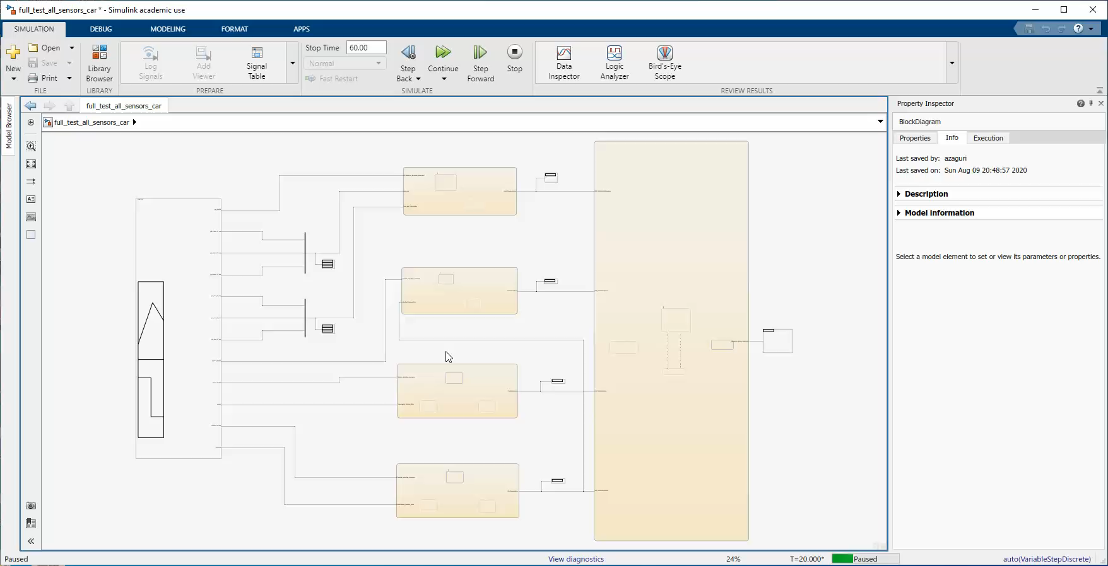
Video Of Simulation

Slide 35
Example of a scenario - an accident (damage to the car body)
Description of the show | Show | Accident - damage to the body of the car
The pressure sensors detected a blow to the car body at 30k psi, The pressure sensors detected the blow that was below the low threshold. Due to the debilitating damage, the camera sensors were not activated and no alert was sent to the control center. | Show 1
The pressure sensors detected a blow to the car body at 40k psi, The pressure sensors detected the blow that was above the low threshold, but below the high threshold, due to the moderate impact the camera sensors were not activated and an alert was sent to the control center. | Show 2
The pressure sensors detected a blow to the car body at 130k psi, The pressure sensors detected the blow that was above the high threshold, due to the strong impact the camera sensors were activated and an alert was sent to the control center. | Show 3

Slide 36
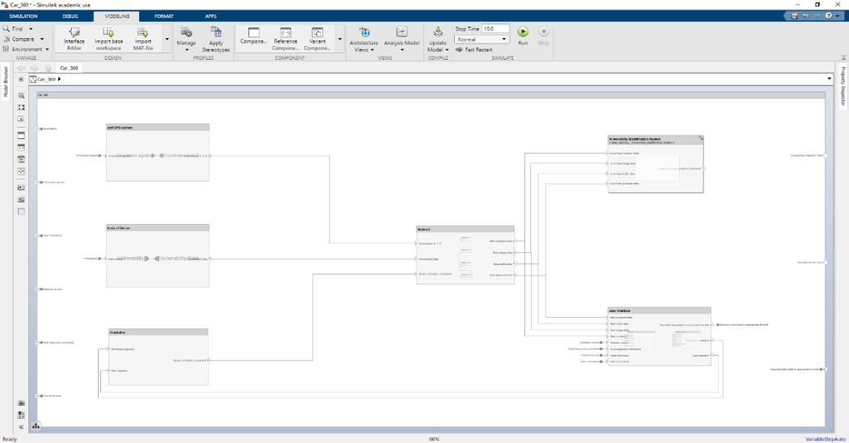
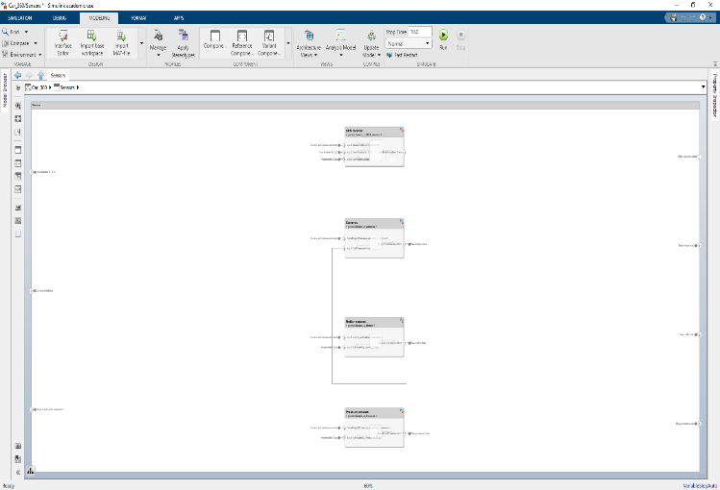
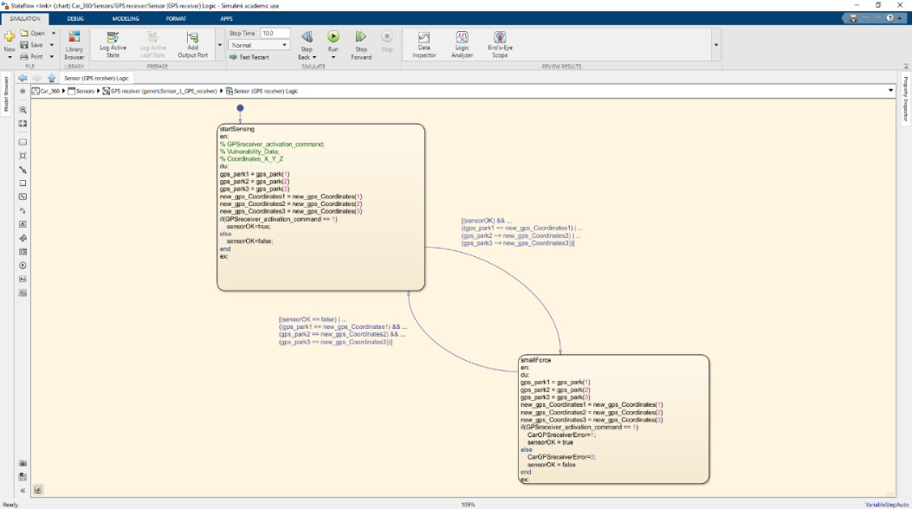
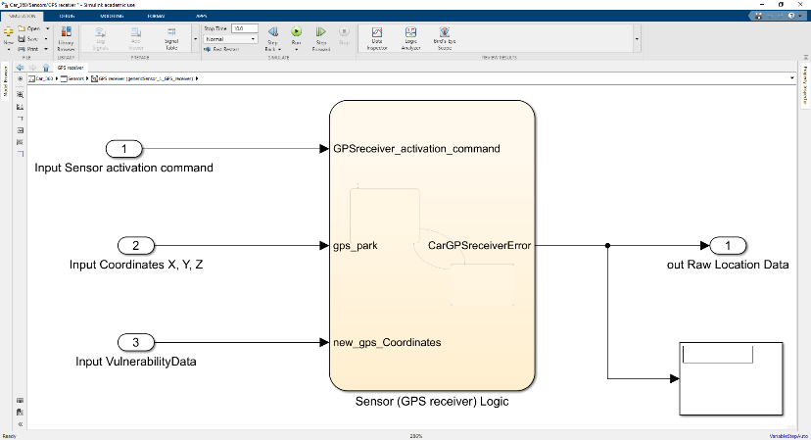
Design validation by simulation
Decrease in the resolution of the layers to the level of the component itself (sensors)
Complex simulation capabilities, with capabilities for analyzing, building models, and running simulations in a simple way
Performing simulations at the individual component level and the overall system level
Finding faults and saving a lot of resources

Slide 37
(short movie to be presented in the conference)

Slide 38
Main Conclusions of the Research
There was no need for a special tool use course
The use of modeling tools makes it possible to reduce the investment time in "free drawings"
Working with a single modeling tool that includes all aspects of the use phase enables overall system modeling as well as etailed components modelling and integration
The objective to perform systemic simulations, as comprehensive as possible, as early as possible in the project, using automation is close at hand
There is a great chance of assimilation in industry in complex projects - further research is planned and collaboration with industry

Slide 39
Future Directions
Continuation of current research in collaboration with industry
Linking the systemic layer to the physical modeling of the components
Automation of system simulation and report generation
Use of tools from the world of "OPEN SOURCE" for the initial concept phase
Examining the continuation and deepening of the research within the framework of a third degree
Further research in industrial modeling, analysis and system simulation using SysML v2
Using of tools as standard in HIT systems engineering courses (starting 2020-21 academic year)
Option to use tools and examples in IoT and CIM courses

Slide 40
Questions ?

Slide 41
Thanks !

